Slide 1

IOT BASED FAULT DETECTING AND INDICATION SYSTEM
DEPARTMENT OF INFORMATION TECHNOLOGY
TEAMMATES:
SAKTHI DHASN.K (130720205305)
DHILIP KUMAR.D (130720205303)
PROJECTGUIDE:
MS.CHRISTY GRACE
BATCH NO:17
.

Slide 2
.
DOMAIN:IOT
COMPONENT USING:ARDUINO UNO
.

Slide 3
ABSTRACT:
The fault location detection has been a goal of power system engineers, since the creation of distribution and transmission systems.
Quick fault detection can help protect the equipment by allowing the disconnection of faulted lines before any significant damage of the equipment.
The accurate fault location can help utility personnel remove persistent of the faults and locate the areas where the faults regularly occur, thus reducing the occurrence of fault and minimize the time of power outages .
As a result, while the fault location detection schemes have been developed in the past, a variety of algorithms continue to be developed to perform this task more accurately and more effectively.

Slide 4
INTRODUCTION TO PROJECT:
INTRODUCTION Power system is classified into power generation, transmission and distribution.
Building circuit network is considered to be one of the vital parts of power system, as it connects the supply and the demand.
The fault in the Building circuit network obstruct the supply of power to the consumer.
The loss in Building circuit and distribution network is considered to be very high, compared to other parts of power system.

Slide 5
Problem definition:
The network must be able to transport sensitive data such as current state of the transmission line and control information to and from the transmission grid.
This paper provides a cost optimized framework to design a real time data transmission network.
Delivering this information to the control centre in a cost efficient and timely manner is a critical challenge to be addressed in order to build an intelligent smart grid.

Slide 6
EXsiting system:
Fault detection is essential to the safe operation of electric power transmission and distribution system.
Without some sort of fault detection the automated removal of short circuits from a Buliding in fault detecting system is impossible.
In present systems, there are no simple and effective techniques to automate the fault detection and location.
This process is generally carried out manually as they get information about fault from the side of users.

Slide 7
Proposed system:
The paper consists of underground cable fault detecting system we are going do some modifications on the device for fault detecting and indicating in the building
The paper proposes a very simple, fast efficient and cost-effective approach to identify the fault location in the circuit network.
In this proposed system use of any kind of sensor is absent. Based on the program coded, it senses the voltage drop in the fault line where in it compares with the predefined value for fault condition and sends information to the control centre.

Slide 8
System Components:
Arduino Uno
Current sensing circuit-Combination of resistors and switches
1kilo ohm resistor
Switch button
Double Relays
Display 12*6
Voltage Adapter(5v)

Slide 9
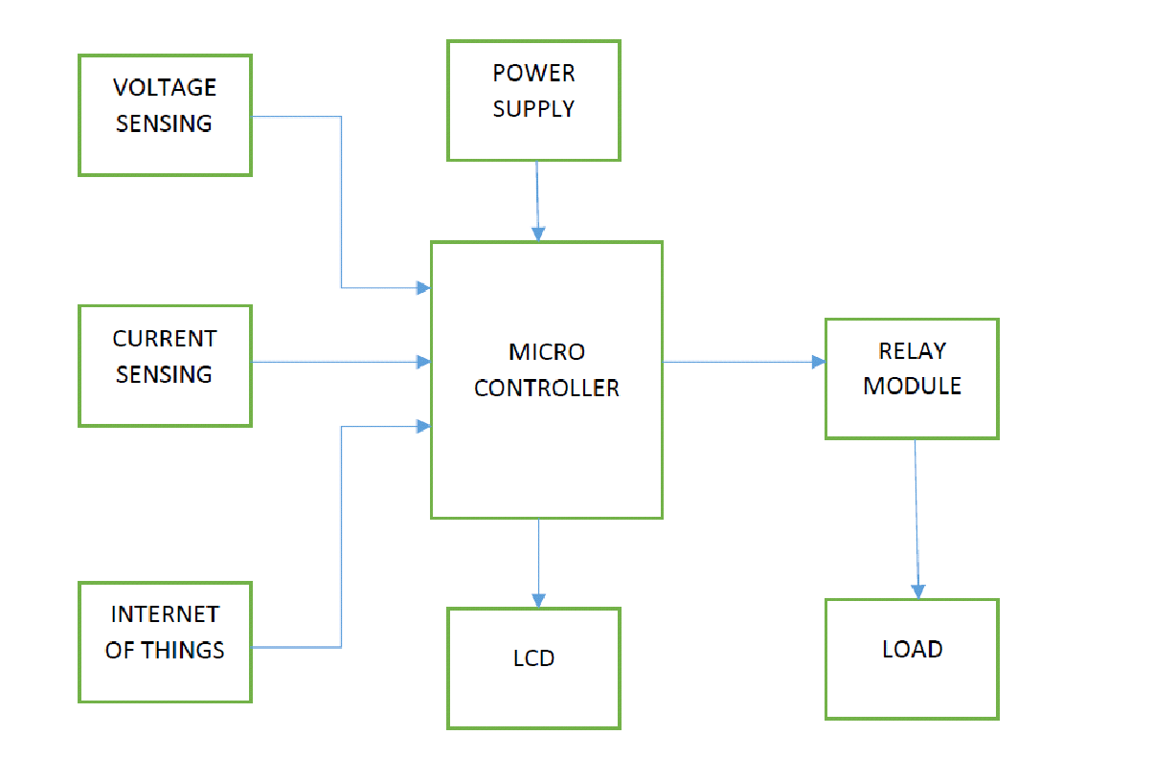
BLOCK DIAGRAM:

Slide 10
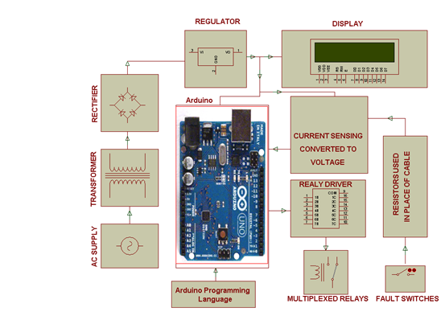
System overview:

Slide 11
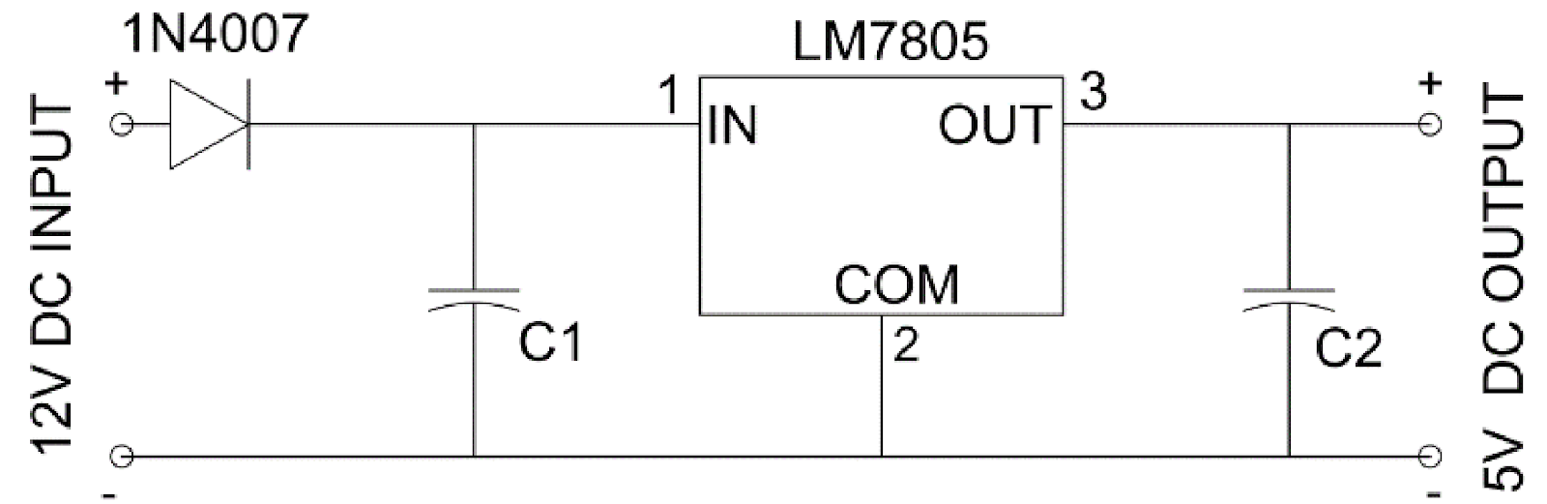
Power supply module:

Slide 12
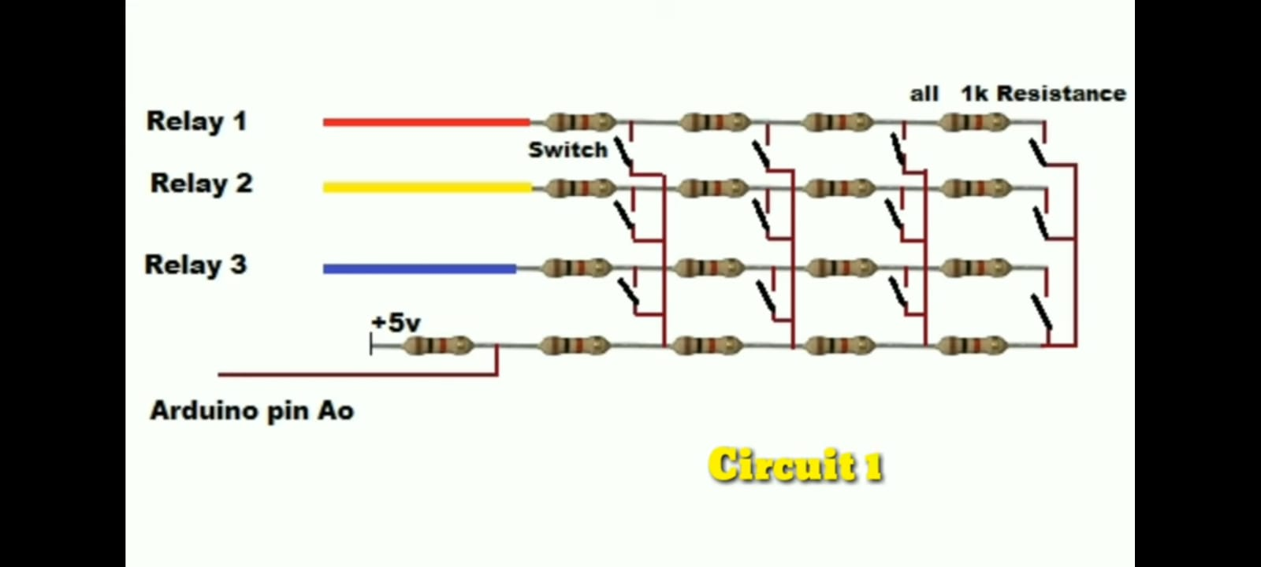
Circuit diagram:

Slide 13
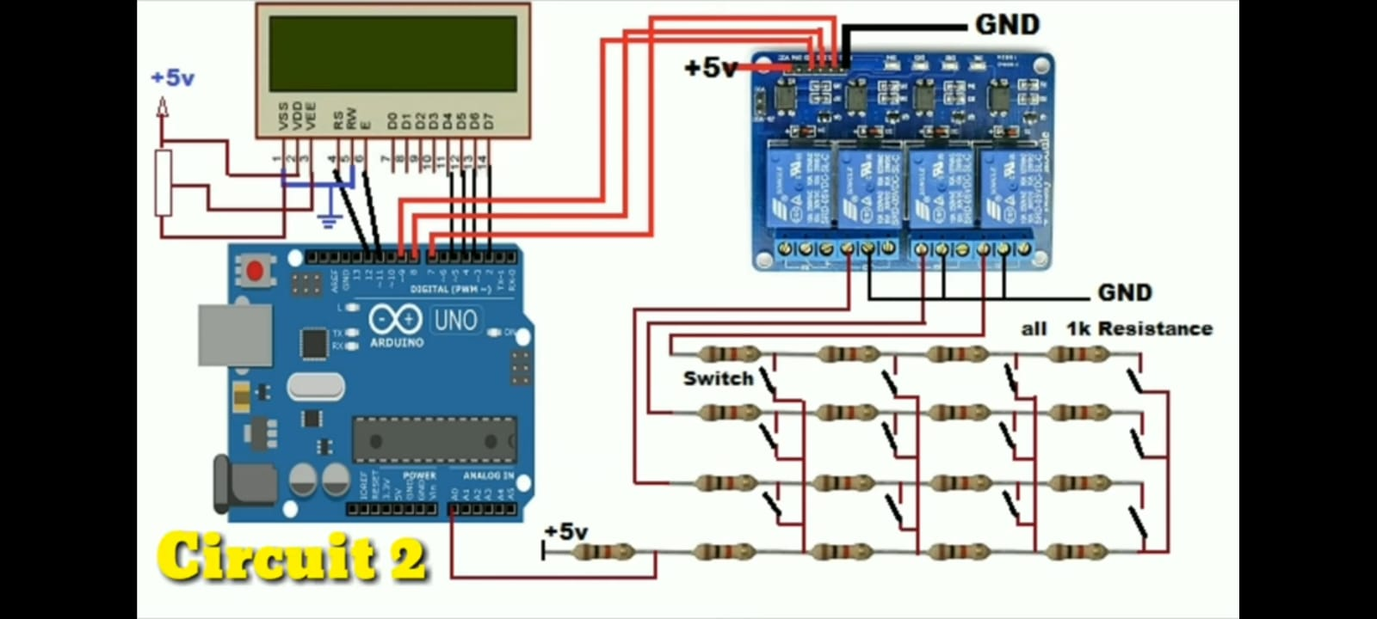
Circuit diagram:

Slide 14
ADVANTAGES:
Work in real time response inter
Coverage area in large compared to existing system
cost efficient
Devices enable by wireless communication
Number of components are used
Economically reliable and low cost

Slide 15
Bill of Quantities:
Component | Quantity | Price(INR)
Arduino Uno | 1 | 1600.00
Resistors | 20 | 100.00
Switch button | 12 | 60
LED | 5 | 50.00
LCD | 1 | 400.00
Relay and Relay driver | 4 | 800.00
Connecting wires | 2set | 200
Bread board | 1 | 100
TOTAL | 32 | 3310.00

Slide 16
REFERENCES:
[1]. L. Goswami, M. K. Kaushik, R. Sikka, V. Anand, K. Prasad Sharma and M. Singh Solanki, "IOT Based Fault Detection of Underground Cables through Node MCU Module," 2020 International Conference on Computer Science, Engineering and Applications (ICCSEA), Gunupur, India, 2020, pp. 1-6, doi: 10.1109/ICCSEA49143.2020.9132893.
[2]. Goswami and P. Agrawal, "IOT based Diagnosing of Fault Detection in Power Line Transmission through GOOGLE Firebase database," 2020 4th International Conference on Trends in Electronics and Informatics (ICOEI)(48184), Tirunelveli, India, 2020, pp. 415-420, doi: 10.1109/ICOEI48184.2020.9143007.
[3]. Baoan Lia, Jianjun Yub “Research and application on the smart home based onComponent technologies and Internet of Things”.
[4]. Suk Lee, Kyoung Nam Ha, Kyung Chang Lee, “A Pyroelectric Infrared Sensor-based Indoor Location-Aware System for the Smart Home”.

Slide 17


